Slide 1
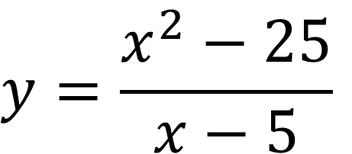
Bell Work (5 – 7 minutes) – Work in Groups
Graph then state the domain, range, x-intercept, y-intercept, vertical and horizontal asymptotes, holes. If an item does not exist, write ‘none’
$$y=\frac{x^{2}−25}{x−5}$$

Slide 2
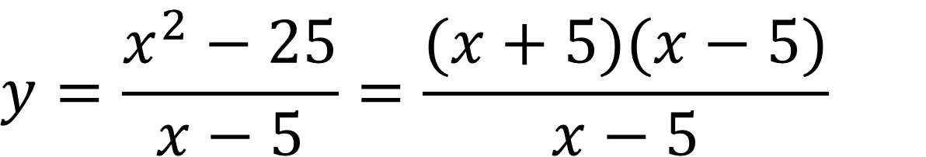
Answer: (5 – 7 min)
$$y=\frac{x^{2}−25}{x−5}=\frac{(x+5)(x−5)}{x−5}$$
Domain: All Real Numbers except 5 (what makes denominator 0? Can’t use it)
Range: All Real Numbers except 10 (10 would be answer if we could plug in 5, but since we can’t plug in 5… we can’t get 10 as an answer)
X-intercept: (-5, 0) (Calculator… F5 – Root)
Y-intercept: (0, -5) (Calculator… F5 – y-intercept)
Vertical Asymptote: None (it would have been at 5, but (x-5) cancels out so it becomes a hole instead)
Horizontal Asymptote: None (review next slide from last class for H.A. rules)
Hole(s): 5 (this would have been an V.A. but since (x-5) canceled it becomes a hole)

Slide 3
Asymptote Rules (From Last Class) Get this copied into notes if you don’t have it!
Vertical Asymptote: set denominator equal to 0 and solve for x… if the expression (x - #) cancels out… it is actually a hole not a VA
Horizontal Asymptote: -- if degree in numerator is smaller than degree in the denominator: H.A is at y=0
-- if degree in numerator is bigger than degree in the denominator: no horizontal asymptote
-- if degree is equal then horizontal asymptote is at # you get when you divide the lead coefficients

Slide 4
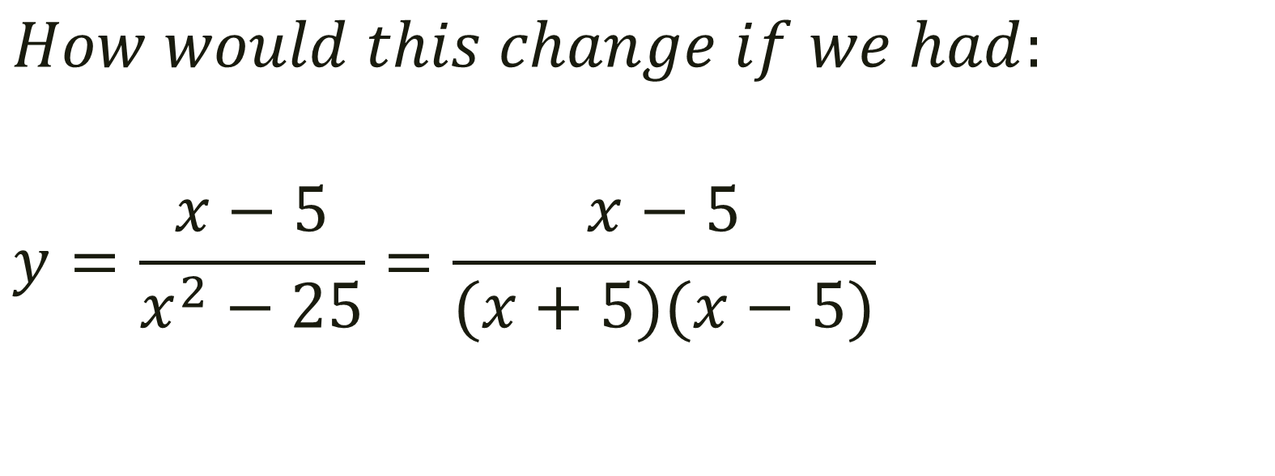
Follow up question… (5 – 7 minutes)
$$How would this change if we had:$$
$$y=\frac{x−5}{x^{2}−25}=\frac{x−5}{(x+5)(x−5)}$$

Slide 5
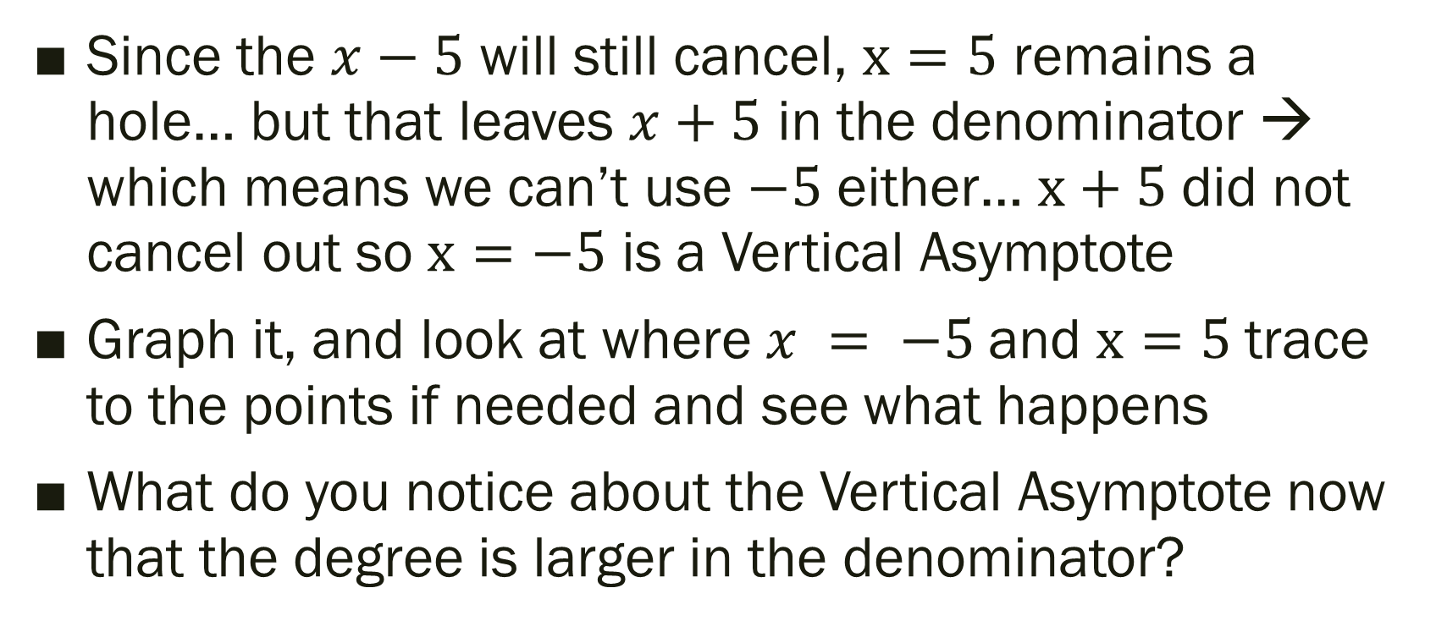
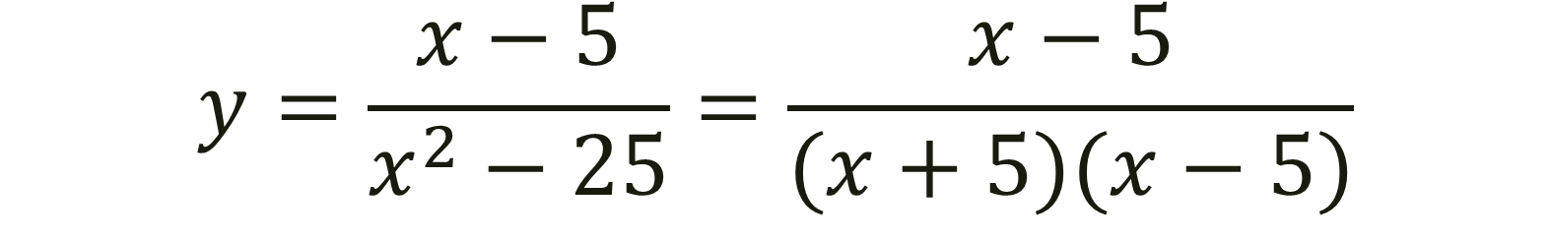
$$y=\frac{x−5}{x^{2}−25}=\frac{x−5}{(x+5)(x−5)}$$
Since the $x−5$ will still cancel, $x=5$ remains a hole… but that leaves $x+5$ in the denominator → which means we can’t use $−5$ either… $x+5$ did not cancel out so $x=−5$ is a Vertical Asymptote
Graph it, and look at where $x = −5$and $x=5$trace to the points if needed and see what happens
What do you notice about the Vertical Asymptote now that the degree is larger in the denominator?

Slide 6
For Last Time… Work in groups and finish this up, or any other missing work (12 – 15 minutes)
Page 190 #9-15(odd), 21, 25, 27, 41, 43, 79

Slide 7
Pre-calc trig
Day 18

Slide 8
12.1 Limits an Intro to Calculus
Objective: Use definition of limits to determine if limits exist and evaluate them
HLQ: How would a limit that approaches infinity impact a rational expression with the only variable being located in the denominator?

Slide 9

Definition of Limit
$If f\left(x\right) becomes arbitrarily close to a unique number L$
$$as x approaches c from either side,$$
$$the limit of f\left(x\right) as x approaches c is L.$$
$$\lim_{x→c}{f\left(x\right)=L}$$
Note:
I know this is a bit wordy… basically… if you can’t plug in a number (c) because it would
break the equation (f(x)) (see bell work) we still want to know what the answer (L) would be if we were allowed to plug (c) into f(x)….
So we are going to test points that are really
close to the c # and see what happens…

Slide 10
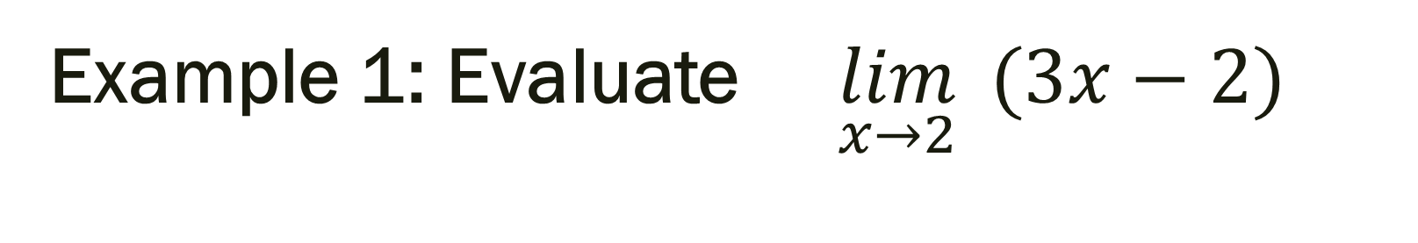
Example 1: Evaluate $\lim_{x→2}{ (3x−2)}$
Explanation of what they want…
So we have f(x) = 3x – 2… and they want us to plug in x = 2… can we do this or does it break?
We know that it equal 4… so that is the answer! But lets pretend we couldn’t plug in 2 for whatever reason… then what would we do try and figure out the answer?

Slide 11
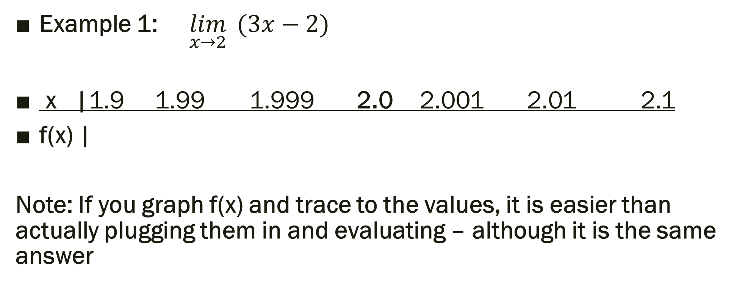
Answer: We would plug in numbers that are really close to 2 on both sides, and see what those values are equal to…
Example 1: $\lim_{x→2}{ (3x−2)}$
x |1.9 1.99 1.999 2.0 2.001 2.01 2.1
f(x) |
Note: If you graph f(x) and trace to the values, it is easier than actually plugging them in and evaluating – although it is the same answer

Slide 12
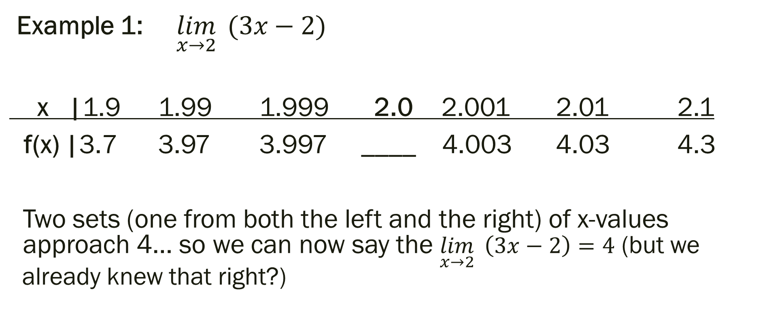
Estimating a Limit Numerically (whether f(x) at x = c exists or not)
Example 1: $\lim_{x→2}{ (3x−2)}$
x |1.9 1.99 1.999 2.0 2.001 2.01 2.1
f(x) |3.7 3.97 3.997 ____ 4.003 4.03 4.3
Two sets (one from both the left and the right) of x-values approach 4… so we can now say the $\lim_{x→2}{ \left(3x−2\right)=4}$ (but we already knew that right?)

Slide 13
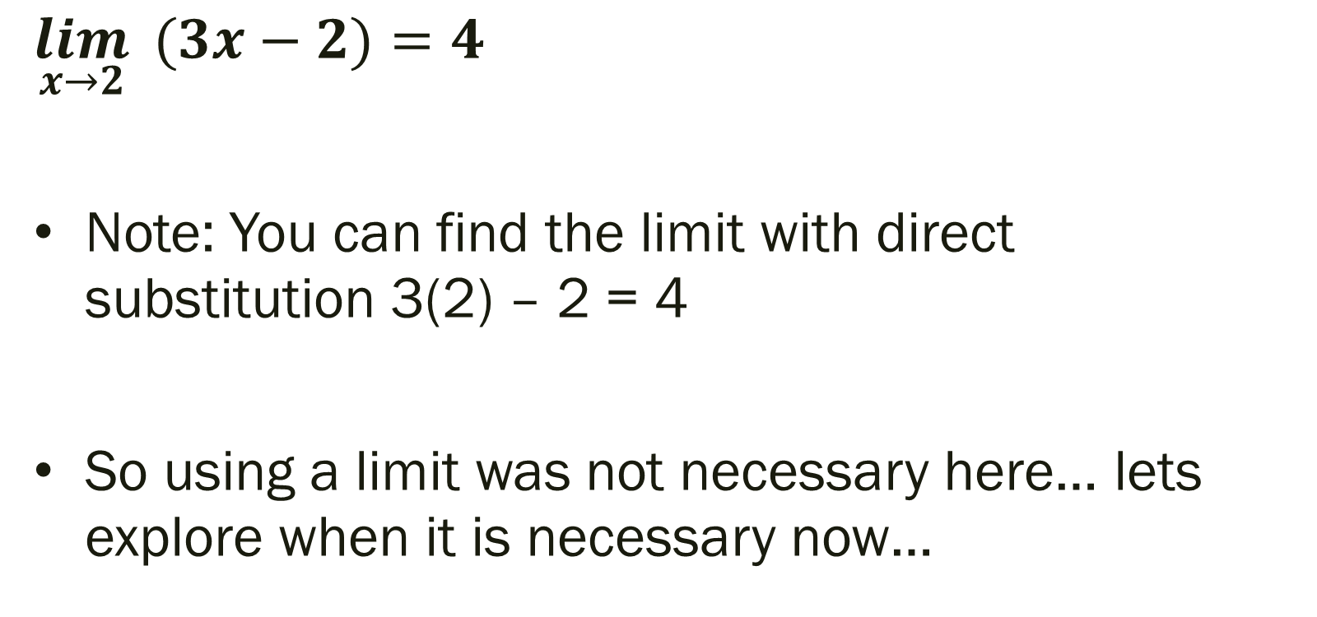
Example 1 Solution:
$$\lim_{x→2}{ (3x−2)}=4$$
Note: You can find the limit with direct substitution 3(2) – 2 = 4
So using a limit was not necessary here… lets explore when it is necessary now…

Slide 14

Example 2: $\lim_{x→2}{\frac{x−2}{x^{2}−4}}$
x | 1.9 1.99 1.999 2.0 2.001 2.01 2.1
f(x) |
Note: If you try and plug 2 in for now… you will get an error (you can NOT divide by zero!!!) So now we must check what the values really close to 2 are equal to and see if we can notice a pattern, or find a number that they are approaching!

Slide 15
Example 2: $\lim_{x→2}{\frac{x−2}{x^{2}−4}}$
x | 1.9 1.99 1.999 2.0 2.001 2.01 2.1
f(x) |.2564 .2506 .25006 _____ .2499 .2493 .2439
Note: If you can’t tell what it is approaching… pick some numbers even closer to 2… like 1.999999999 and 2.00000001 and see what they equal.
It appears that the limit is approaching 0.25

Slide 16
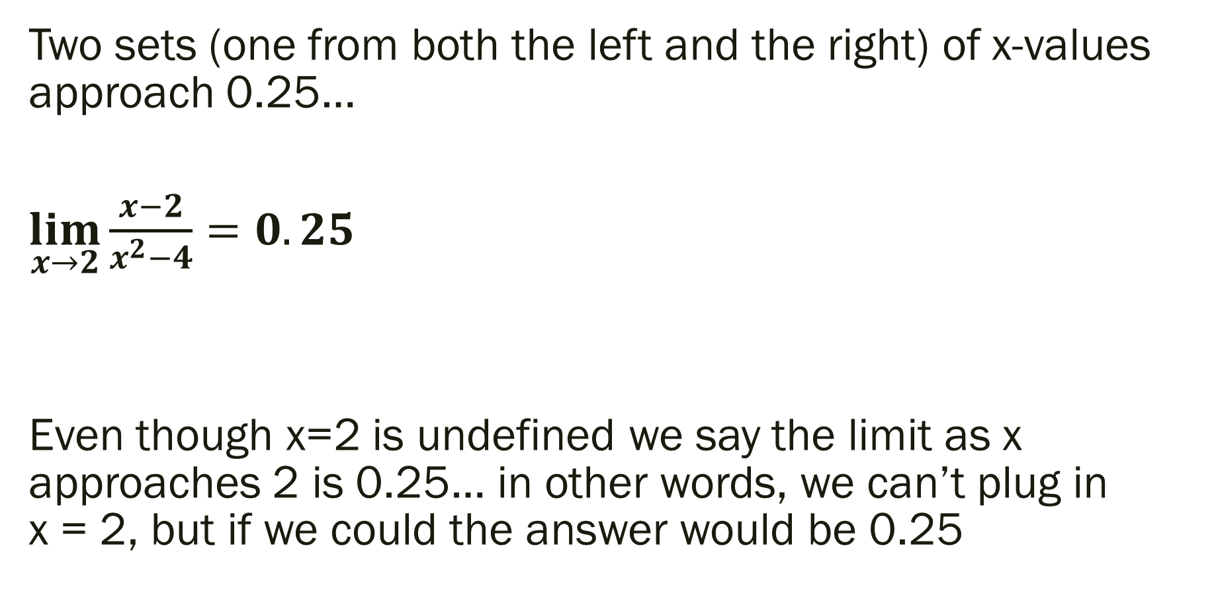
Example 2 Solution
Two sets (one from both the left and the right) of x-values approach 0.25…
$\lim_{x→2}{\frac{x−2}{x^{2}−4}}=0.25$
Even though x=2 is undefined we say the limit as x approaches 2 is 0.25… in other words, we can’t plug in x = 2, but if we could the answer would be 0.25

Slide 17
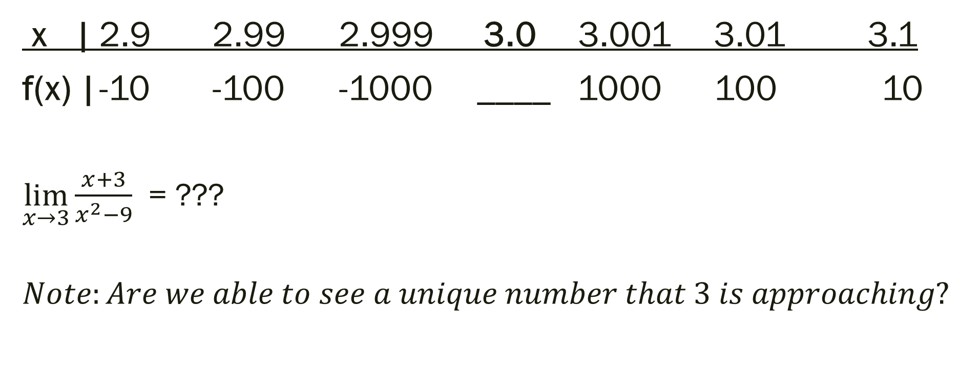

Example 3: $\lim_{x→3}{\frac{x+3}{x^{2}−9}=\frac{x+3}{(x+3)(x−3)}}$
x | 2.9 2.99 2.999 3.0 3.001 3.01 3.1
f(x) | -10 -100 -1000 ____ 1000 100 10
$\lim_{x→3}{\frac{x+3}{x^{2}−9}}$ = ???
$$Note:Are we able to see a unique number that 3 is approaching?$$

Slide 18
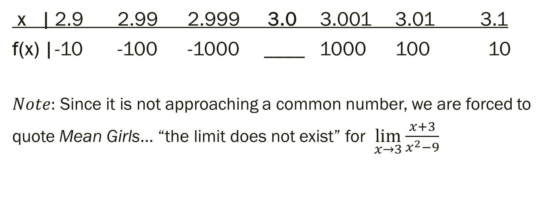
Example 3: $\lim_{x→3}{\frac{x+3}{x^{2}−9}=\frac{x+3}{(x+3)(x−3)}}$
x | 2.9 2.99 2.999 3.0 3.001 3.01 3.1
f(x) | -10 -100 -1000 ____ 1000 100 10
$Note:$ Since it is not approaching a common number, we are forced to
quote Mean Girls… “the limit does not exist” for $\lim_{x→3}\frac{x+3}{x^{2}−9}$

Slide 19

But what if we approached -3 instead of 3?
$\lim_{x→−3}{ \frac{x+3}{x^{2}−9}}=???$

Slide 20
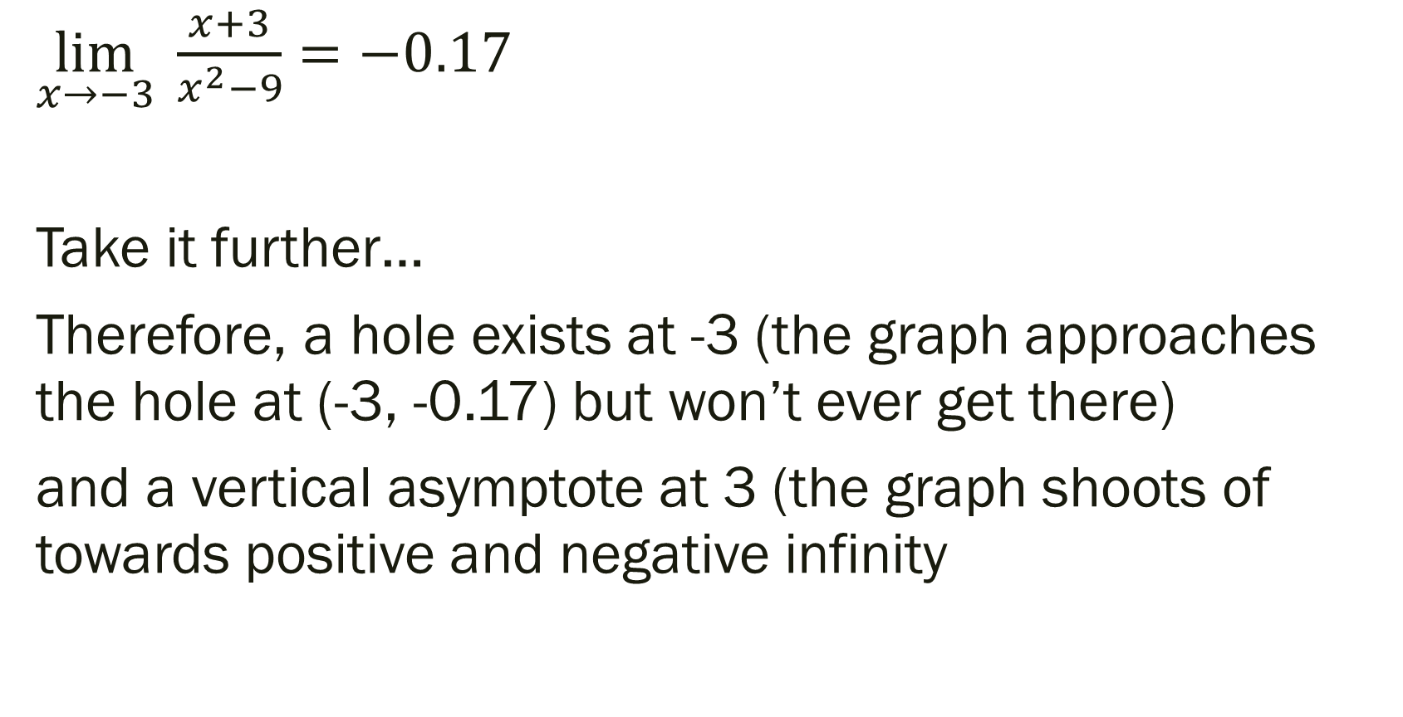
But what if we approached -3 instead of 3?
$\lim_{x→−3}{ \frac{x+3}{x^{2}−9}}=−0.17$
Take it further…
Therefore, a hole exists at -3 (the graph approaches the hole at (-3, -0.17) but won’t ever get there)
and a vertical asymptote at 3 (the graph shoots of towards positive and negative infinity

Slide 21
For next time…
Page 858 #5, 7, 9, 13, 29, 30, 31, 33, 49, 53, 61

